Slide 1
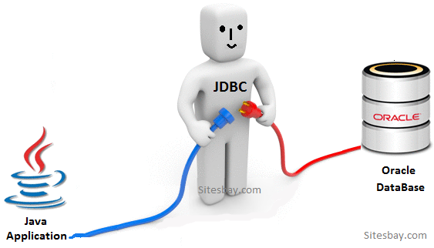
JDBC
Java Database Connectivity
S SHAHRUKH

Slide 2
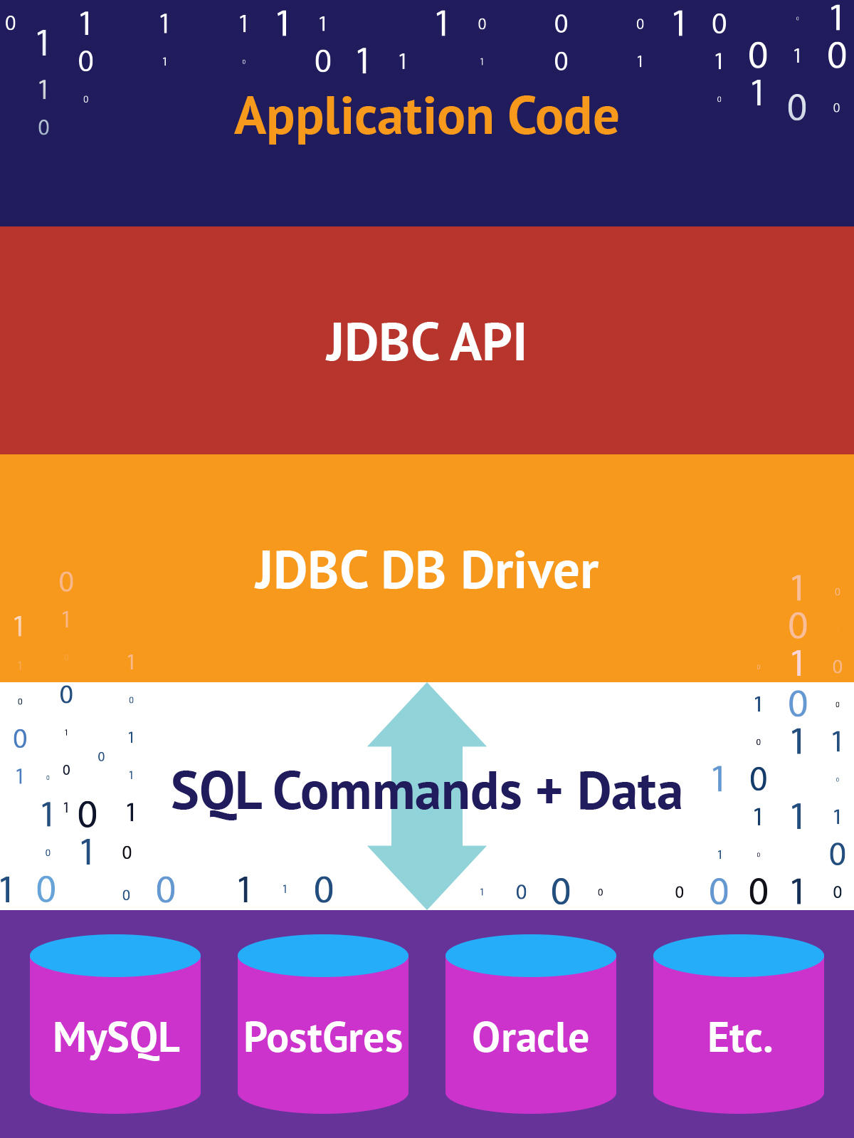
Architecture

Slide 3
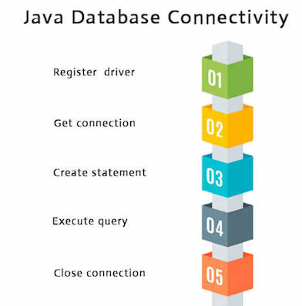
Steps

Slide 4
Advantages
Can read any database if proper drivers are installed.
Creates XML structure of data from database
automatically
No content conversion required
Query and Stored procedure supported.
Can be used for both Synchronous and Asynchronous processing.

Slide 5
Disadvantages
Correct drivers need to be deployed for each type of database
Cannot update or insert multiple tables with sequence. ( Sequence is always random)

Slide 6
THANK-YOU

